Slide 1
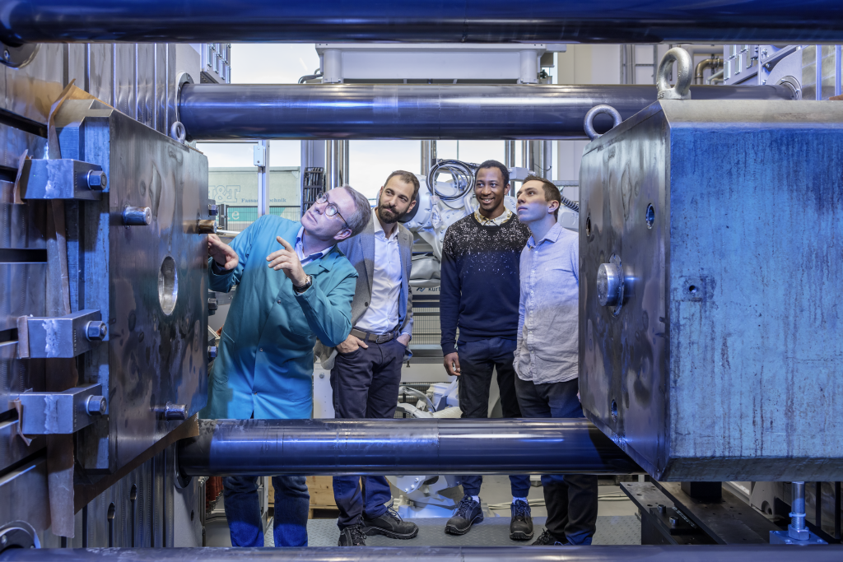


Modern Slavery and Human Trafficking Act Statement 2020
Publishing Date: June 2021
Bühler UK, London.
This statement has been published in accordance with the Modern Slavery Act 2015. References to ‘us’, ‘our’, or ‘we’ are to Bühler UK Holdings and its affiliates and subsidiaries.
Innovations for a better world.

Slide 2
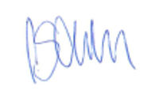
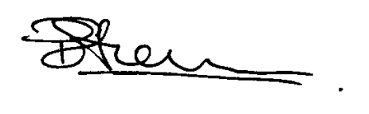


Statement from the Board Of Directors
Every day, billions of people come into contact with Bühler technologies to cover their basic needs for food and mobility. We are striving for innovations for a better world, with a special focus on healthy, safe, and sustainable solutions. With sales around CHF3bn and 13,000 employees we have operations in 140 countries across Europe, Africa, Middle East, the Americas, Asia and Australia.
Modern slavery is a crime and a violation of fundamental human rights. It takes various forms, such as slavery, servitude, forced and compulsory labour and human trafficking, all of which have in common the deprivation of a person’s liberty by another in order to exploit them for personal or commercial gain.
Bühler has a zero-tolerance approach to modern slavery, and we are committed to acting ethically and with integrity in all our business dealings and relationships and to implementing and enforcing effective systems and controls to ensure modern slavery is not taking place anywhere in our own business or in any of our supply chains. We are also committed to ensuring there is transparency in our own business and in our approach to tackling modern slavery throughout our supply chains, consistent with our disclosure obligations under the Modern Slavery Act 2015.
This policy applies to all persons working for us or on our behalf in any capacity, including employees at all levels, directors, officers, agency workers, seconded workers, volunteers, interns, agents, contractors, external consultants, third-party representatives and business partners.
This statement is published in accordance with the UK Modern Slavery Act 2015 and covers Bühler UK and other Bühler Group Companies. We will monitor the need for further action to be taken and other key performance indicators to be implemented as we continue our risk assessment and due diligence activities. This statement has been approved by the Bühler UK Board of Directors who will review and update it annually.
Carmen Schlatter – MD Digital Technologies Paul Silverman – MD Bühler UK (SAS)
July 2021

Slide 3
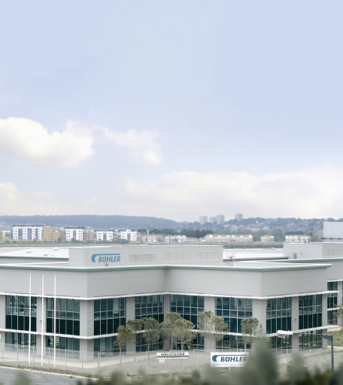
Our business
Founded in 1860 in Switzerland and established in the 1960s in the United Kingdom, Bühler is a global manufacturing and engineering company present in all continents. Our main activities include the design, manufacturing and global distribution of cleaning and sorting machinery as well as the supply of machinery and complete plants for the flour and feed, milling, cereal processing, chocolate, printing ink, die casting, mechanical and pneumatic conveying industries and the supply of control systems.
In the UK alone, Bühler employs more than 350 people from multiple backgrounds and nationalities across our sites in London, Manchester and Peterborough. Due to the large scale of our supply chain system, we work closely with different stakeholders such as suppliers, partners and external agents, based both worldwide and in the UK.
Bühler’s mission is to ensure a sustainable, successful and independent development of the Group through the products, processes, and services we offer. This mission is founded by what we call four success factors:
Productivity
Market Leadership
Differentiation
Best people
Bühler UK Limited. | Slavery and Human Trafficking Statement

Slide 4

Definition of modern slavery
Modern slavery includes a range of types of exploitation, many of which occur together. These include but are not limited to:
Sexual exploitation: this includes sexual abuse, prostitution and the abuse of children for the production of child abuse images/videos.
Domestics servitude: this involves victims being forced to work in usually private households, performing domestic chores and childcare duties.
Forced labour: this can happen in various industries, including construction, manufacturing,hospitality, food packaging, agriculture, maritime and beauty and many more.
Criminal exploitation: this can be understood as the exploitation of a person to commit a crime, such as pick-pocketing, shop-lifting, drug trafficking and other similar activities that are subject to penalties and imply financial gain for the trafficker.
Other forms of exploitation include organ removal, forced begging fraud, forced marriage and illegal adoption.

Slide 5

Our policies
Both our Head Office and Bühler UK are highly committed to ensure a working environment free from modern slavery or human trafficking in any part of our business.
Group Level policies
Bühler’s Supplier Code of Conduct sets out our expectations on Supplier behavior in four pillars, one of which is the respect for human rights. This includes the rejection of forced labor and child labor, the fair and equal treatment for all employees, freedom of association and collective bargaining, the right to rest and a fair compensation.
Our Head Office have also made available a Whistleblowing Procedure by which any wrongdoing or unfair practice taking place both inside and outside the organisation coming to the attention of any employee can be reported and escalated to Group Compliance for further action. This includes any violation of human trafficking laws by a Bühler supplier.
Our Head Office take compliance with Modern Slavery laws very seriously. On a bi-monthly basis, every Bühler entity across the world is required to report about the latest actions undertaken for a different number of local and international laws and regulations to ensure we, as a sum of local entities and a Group, pay the necessary attention to our Company legalities and reinforce our actions to minimise any potential risks.
Other relevant Group actions for the year 2019 include the review and update of all Bühler standard commercial documents used with our suppliers worldwide (Purchase Agreements, terms and conditions) in order to make reference to the UK’s Modern Slavery Act 2015 as a commitment to strengthen our determination to keep it away from our Supply Chain. This measure came into effect after receiving advice and an in-depth review from qualified English lawyers.
1
Bühler UK Limited. | Slavery and Human Trafficking Statement

Slide 6
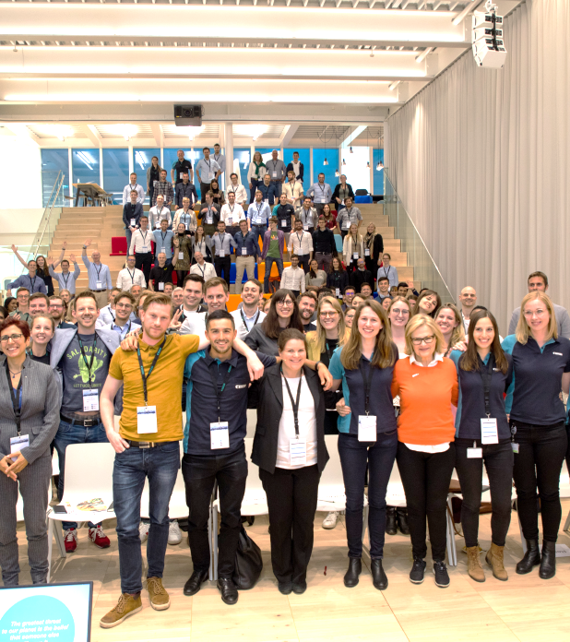
Our policies
Local policies
Bühler UK is also highly committed at a regional level. Our local policies include an Equality Policy which aims to fight discrimination, harassment and victimisation of any employee. Further to that, a Dignity at Work Policy has been put in place to prevent bullying amongst employees in relation with someone’s race, sex and religious beliefs. Bühler UK also has in place Break, Flexi Time and Grievance Policies, setting out employee’s different entitlements with regard to time off compensation when they work overtime as well as leave eligibility. Furthermore, our Contracts of Employment are provided with all relevant information related to working hours, annual leave and data protection.
Our Human Resources Team ensures these policies are implemented correctly within our organisation and are responsible to monitor and update the documents when necessary to make them fit for purpose at all times.
2
Bühler UK Limited. | Slavery and Human Trafficking Statement

Slide 7
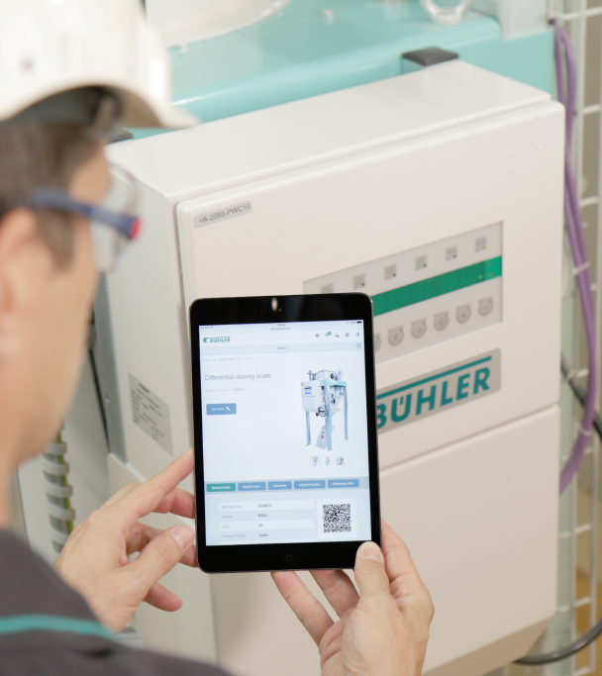
Due Diligence
We reject any and all forms of forced labor and human trafficking and respect the principle of freely chosen employment.
As a global company with multiple production sites across the world and global sourcing, we acknowledge our business is in the spotlight and must take all necessary measures to mitigate the risks of being involved in or working with partners who are involved in human trafficking activities.
As previously mentioned, we count with our Headquarters’ support to implement measures which tackle Human Trafficking and Modern slavery and we have started doing so by updating our standard commercial documents, keeping our Headquarters informed and being informed about our Suppliers’ ways of working.
Also as part of our activities to comply with the Modern Slavery Act 2015, we issued a Modern Slavery Statement for our Suppliers (both current and new) and requested a signed response from them as proof of compliance. We received a positive answer from more than one hundred suppliers who represented 73% of our buying spend for the previous year (2020). This gives us a more robust proof of a clean and transparent supply chain and it also contributes to a more trustworthy relationship with our suppliers. In 2021 we will continue to request a response from the remaining 27%.
Also, we hosted an in-house training for our Manufacturing team where the Modern Slavery Act was discussed and explained in detail to those employees who might come across it as they deal directly with our external supply chain.
Bühler UK Limited. | Slavery and Human Trafficking Statement

Slide 8
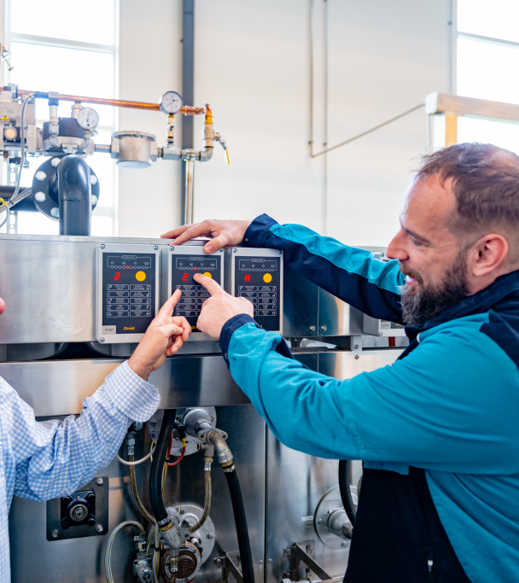
Training
To ensure high level of understanding of the risks of modern slavery and human trafficking in our business, in our supply chains and in our business partners, we provide relevant training to our staff.
Future steps
As part of our ongoing activities to comply with the Modern Slavery Act 2015, we are currently establishing a risk check process for any new supplier that Bühler UK takes on board as well as a Supplier questionnaire which will be sent out to learn more in depth about our suppliers’ practices in important matters for us such as workforce, labour conditions and environment.
As mentioned previously we will continue to request a response to our Modern Slavery Statement from existing customers.
Bühler UK Limited. | Slavery and Human Trafficking Statement

Slide 9

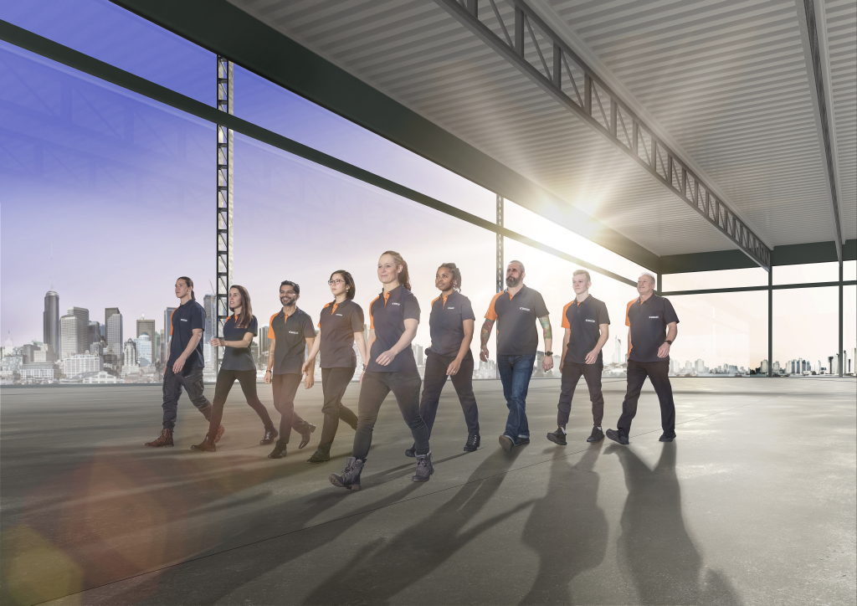

Innovations for a better world.
Buhler UK Limited. | Slavery and Human Trafficking Statement

